Slide 1
XMLHttpRequest Level 2
Parker Zhou
parkerzho2010@gmail.com

Slide 2
XMLHttpRequest
Allow the data to be retrieved from or post to server without full page refreshing
Used in AJAX programming
Less transmission, more user experience
Very important in modern web development, specially on mobile device

Slide 3
Level 1
var myRequest = new XMLHttpRequest();
//in IE
var myRequest = new ActiveXObject("microsoft.xmlhttp");
Property | Description
onreadystatechange | Event handler for the async request operation
readyState | Request state
responseText | Response as text
responseXML | Response as XML object
status | Status code
statusText | Status code description

Slide 4
Level 1
function | Description
abort | Abort the request
getAllResponseHeaders | Get all response’s header
getResponseHeader
open(method,url,async) | Create and initial a request
send | Send request
setRequestHeader | Set request header
myRequest.open("GET",url,true);
myRequest.onreadystatechange = function(){
if(myRequest.readyState==4){
if(myRequest.status==200){
//myRequest.responseText
}
}
}
myRequest.send(null);

Slide 5
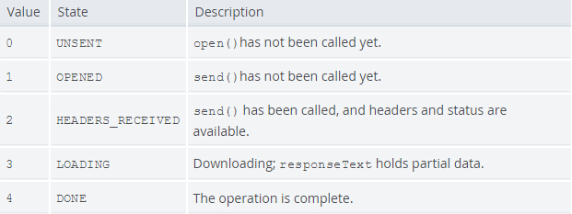
Level 1

Slide 6
Level 1 problem
Text only
Lack of progress
Cross-Origin limitation

Slide 7
Level 2
Set timeout
myRequest.timeout = 3000;
myRequest.timeout = function(){}

Slide 8
Level 2
FormData
var formData = new FormData();
formData.append('username', 'Alice');
formData.append('age', 28);
myRequest.send(formData);

Slide 9
Level 2
File upload
var $file = $(‘input[type="file"]’)
var files = $file.get(0).files; //FileList
var formData = new FormData();
formData.append(‘some_key', files[0]);
myRequest.send(formData);
//slice file upload
var $file = $(‘input[type="file"]’)
var files = $file.get(0).files; //FileList
var chunked = files[0].slice(start, seek); //Blob
var formData = new FormData();
formData.append(files[0].name, chunked);

Slide 10
Level 2
binary data fetch
var myRequest = new XMLHttpRequest();
myRequest.responseType = 'blob';
myRequest.onload = onLoadHandler;
myRequest.open('GET', '/path/to/image.png‘,true);
var onLoadHandler = function(event){
var blob = new Blob([event.target.response], {type: 'image/png'});
…
}
Notes:
http://www.w3.org/TR/file-upload/

Slide 11
Level 2
Progress can be known
myRequest.upload.onprogress = updateProgress;
function updateProgress(event) {
if (event.lengthComputable) {
var percentComplete = event.loaded / event.total;
}
}

Slide 12
Level 2
Cross-Origin using CORS
OPTIONS /resources/post-here/ HTTP/1.1
Host: bar.other
…
Origin: http://foo.example
Access-Control-Request-Method: POST
Access-Control-Request-Headers: X-PINGOTHER
HTTP/1.1 200 OK
Access-Control-Allow-Origin: http://foo.example
Access-Control-Allow-Methods: POST, GET, OPTIONS
Access-Control-Allow-Headers: X-PINGOTHER
Access-Control-Max-Age: 1728000
…
Notes:
Sample : http://mobile.test.clippererm.com/

